Slide 1
Chapter 10
Routing Protocol Basics

Slide 2
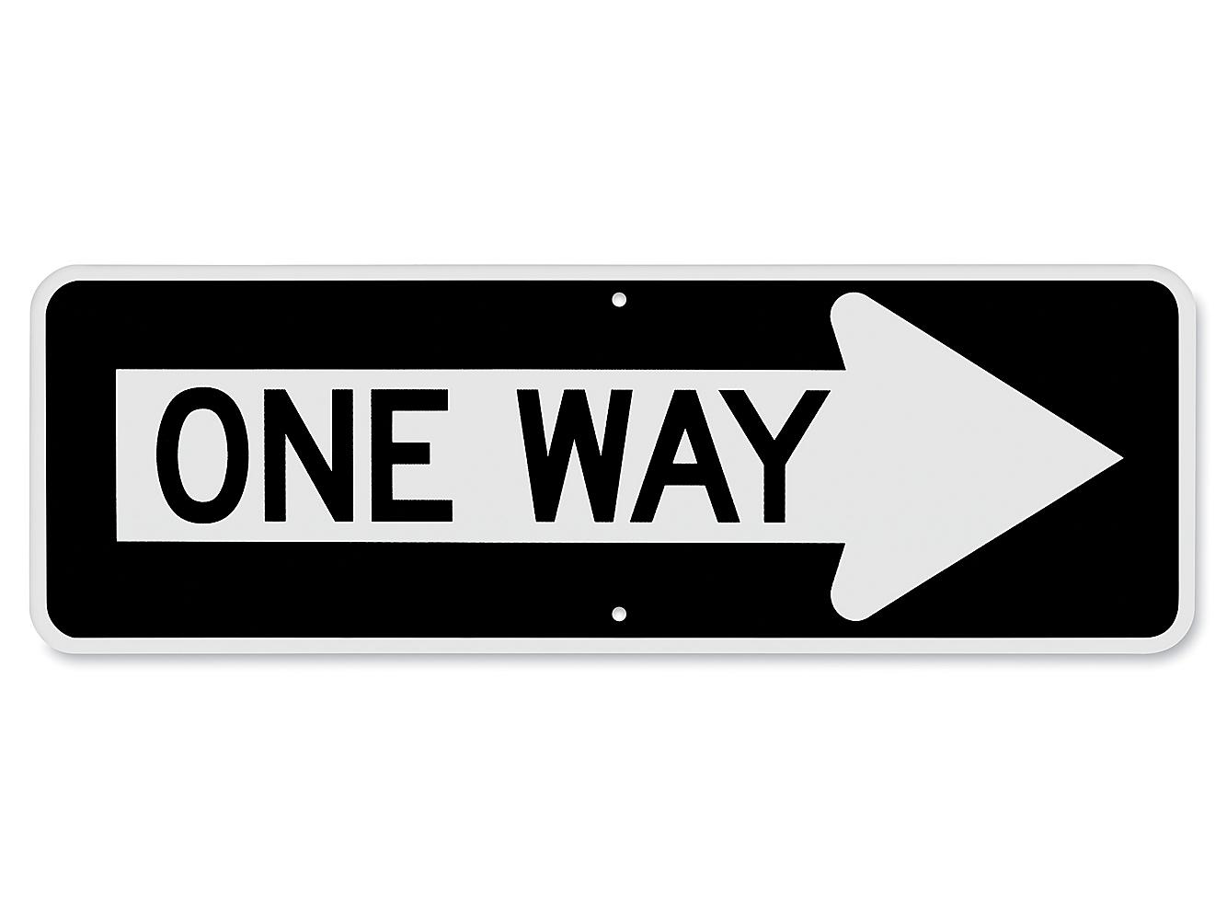
Default Route
You can’t configure a route for every single destination across the world
Used when nothing else in the routing table matches
Keeps traffic flowing where it needs to go
Common Route destination is 0.0.0.0/0

Slide 3
Administrative Distance
Route Source | Default AD
Connected | 0
Static | 1
BGP | 20
EIGRP | 90
IGRP | 100
OSPF | 110
RIP | 120
The administrative distance (AD) is used to rate the trustworthiness of routing information received on one router from its neighboring router.
Notes:
Utilized when you have multiple routing protocols on your routers
CISCO software that ranks the reliability and trustworthiness of a specific routing protocol
Ranked from most to least reliable

Slide 4
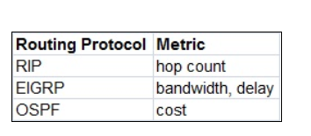
Routing Metrics
Different Routing Protocols have different metrics for deciding on the best route
The lower the number, the better the route
Cost = Reference Bandwidth / Interface Bandwidth
Notes:
Hop count: the amount of hops it would take to get to a specific destination. Chooses the least amount of hops
Bandwidth and delay: Based on the speeds of that route and you can manually configure a delay to influence your routing information to take a preferred path
Cost: Based on the bandwidth speeds at each router and the link between them to determine the cost
OSPF will prefer the fastest bandwidth

Slide 5
Classes of Routing Protocols
Distance Vector – Find the best path to a remote network by judging distance. Each time a packet goes through a router we call it a hop. The route with fewest hops to the network is determined to be the best route.
Link State – Link State protocols create three separate tables. One of these tables keeps track of directly attached neighbors, one determines the topology of the entire internetwork, and one is used as the actual routing table. Link-state routers know more about the internetwork than any distance-vector routing protocol.
Hybrid – A hybrid protocol uses the best aspects of both distance vector and link state routing protocols. At this time, there’s EIGRP and BGP. EIGRP happens to be a Cisco proprietary protocol, meaning that it will only run on Cisco equipment. If you have a multi-vendor environment, this won’t work for you.
Notes:
Distance: Find the best route by choosing the least amount of hops
Link-state: creates 3 separate tables
1 table to keep track of directly attached neighbors
1 determines the topology of the entire internetwork
1 is the actual route table
Hybrid: Combines both aspects of distance vector and link-state

Slide 6
Distance Vector Routing
Not preferred
Based on hop count
Used with rip or rip v2
Rip v1 no vlsm
Rip v2 yes vlsm
Max hop count 15
Notes:
Routing Information Protocol: sends the complete routing table out to all active interfaces in 30 seconds
Uses hop count
Maximum of 15 hops allowed
Works well in small networks
Version 1 uses classful routing; means that all devices in the network must use the same subnet mask for each specific address class
Version 2 uses prefix routing and sends subnet mask information w/ route updates; this is classless routing
Version 2 can support variable-length subnet masks
This is beneficial because VLSMs allow different subnet masks for different interfaces

Slide 7
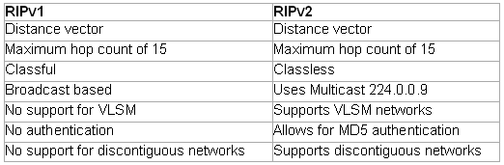
Routing Information Protocol (RIP)
RIP is a true distance-vector routing protocol.
It sends the complete routing table out to all active interfaces every 30 seconds.
RIP uses only one thing to determine the best way to a remote network—the hop count.
RIP has a maximum allowable hop count of 15 by default, a hop count of 16 would be deemed unreachable.
Notes:
RIP uses Hop count to determine the best route
Version 1 doesn’t send updates regarding subnet mask information
Version 2 does send updates with subnet mask information

Slide 8
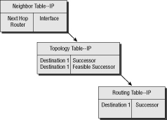
EIGRP
A great feature of EIGRP is that it’s simple to configure and turn on like a distance-vector protocol, but it keeps track of more information than a distance vector does.
It creates and maintains additional tables instead of just one table as distance-vector routing protocols do.
These tables are called the neighbor table, topology table, and routing table.
Notes:
Proprietary protocol, created by CISCO
Advanced distance-vector protocol
Shares routes within the same Autonomous System
Runs separate routing for IPv4 and IPv6
Neighbor table: table with state information about adjacent neighbors
Topology table: contains all destinations advertised by neighboring routers, holding each destination address, and a list of neighbors that have advertised the destination

Slide 9
Link State
Open Shortest Path First (OSPF)
Interior
Uses the speed and bandwidth calculations
Uses Djikstra Formula
Each router communicates with its neighbor
Every router is aware of the networks topology to make decisions
Not very scalable
Uses an Autonomous system (AS)
Notes:
Autonomous System is the large pool of routers that operate at a single organization
19 routers = AS, based off how that AS is setup OSPF determines the fastest and best route for data

Slide 10
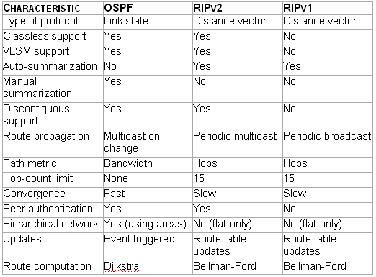
RIP / OSPF Comparison
OSPF is the first link-state routing protocol that most people are introduced to, so it’s good to see how it compares to more traditional distance-vector protocols like RIPv2 and RIPv1.
Notes:
Open standard routing protocol
Uses an algorithm
Constructs a shortest-path tree
A routing tree is made with the resulting best paths
Supports multiple, equal-cost routes to the same destination
Supports both IPv4 and IPv6, but it has a separate database for each

Slide 11
hybrids
Border Gateway protocol (Bgp)
Exterior protocol
Uses autonomous systems in place of hop count
Global version
Routes packets between separate Autonomous systems
Notes:
BGP makes routing decisions based on paths, defined by rules or network policies set by network administrators.

Slide 12




Border Gateway Protocol (BGP)
IGPs: RIP, IGRP, EIGRP, OSPF
EGPs: BGP
Autonomous System 1
Autonomous System 2
Notes:
BGP is used for ISPs to communicate ASs together
Because the Internet’s growth rate shows no signs of slowing, ISPs use BGP for its ability to make classless routing and summarization possible.
These capabilities help to keep routing tables smaller and more efficient at the ISP core.

Slide 13
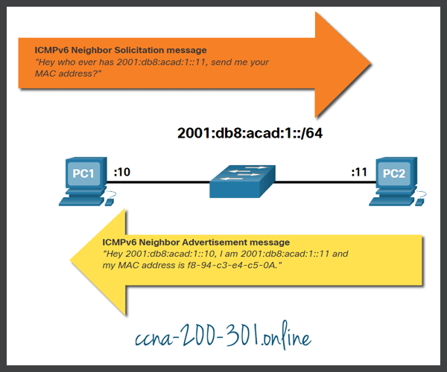
Neighbor Discovery Protocol (NDP)
Notes:
IPv6 doesn’t use Broadcast messages, but it still needs to be able to resolve MAC addressing from IP addresses
Message is sent as a multicast instead of a broadcast

Slide 14
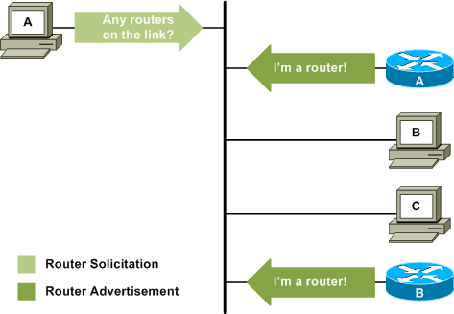
Neighbor Discovery Protocol continued
Notes:
Allows your devices to find out where routers are located on your local subnet
Also uses multicast messages

Slide 15
High availability
First hop Redundancy Protocol
Hot Standby Routing protocol (HSRP)
16 groups max
All routers must have different IP addresses
Virtual Redundancy Routing Protocol (VRRP)
255 Groups max
Ip addresses can be the same as the physical interface
Notes:
Designed to protect the default gateway used on a subnetwork by allowing two or more routers to provide backup for that address
In the event of failure of an active router, the backup router will take over the address, usually within a few seconds.
HSRP: used in a group of routers for selecting an active router and a standby router
VRRP: the default primary device sends advertisements to backup devices at regular intervals.
If a backup device does not receive an advertisement for a set period
The backup device with the next highest priority takes over as primary and begins forwarding packets.

Slide 16
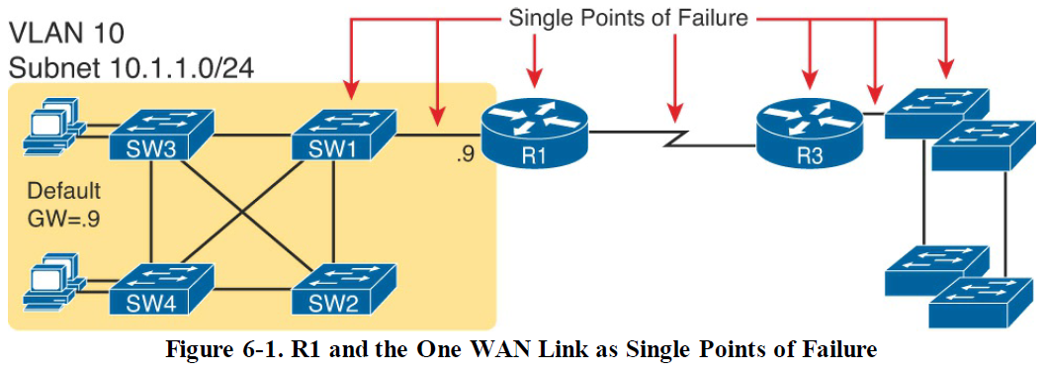
Redundant First Hop Routers

Slide 17
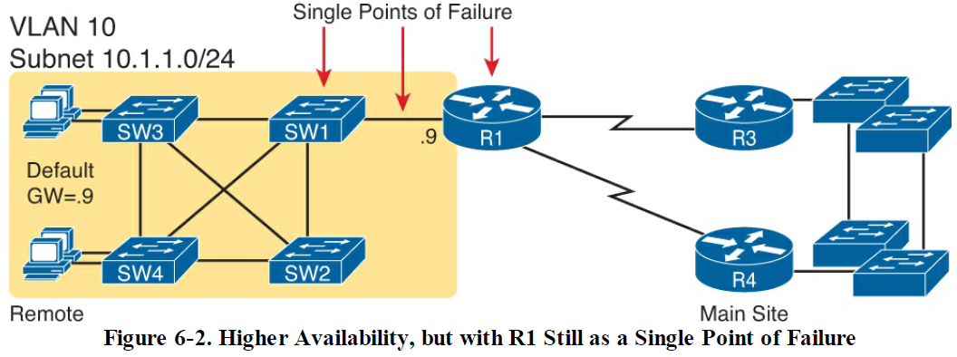
Redundant First Hop Routers

Slide 18
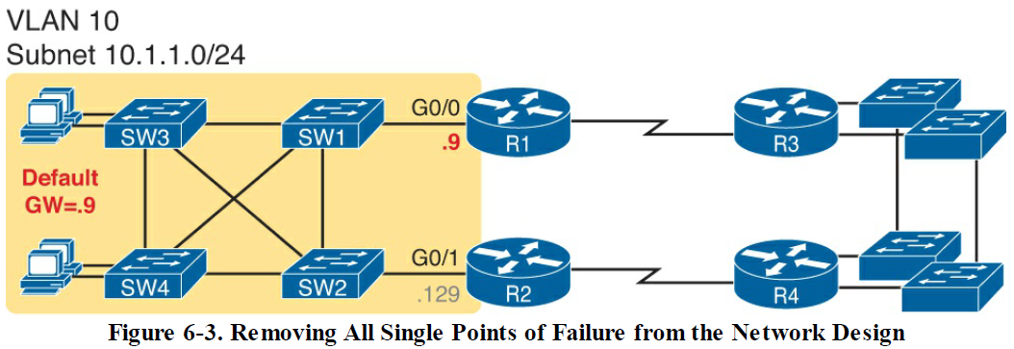
Redundant First Hop Routers

